Slide 1
Restaurant Sales Analysis Dashboard
Created using Power BI
Name: Rohit Kumar
Date: 30 Sept 2025

Slide 2
Objective
Objective of Dashboard
To analyze restaurant sales performance across segments, regions, and product categories.
To identify trends in sales, profit, discount, and quantity.
To provide business stakeholders with clear insights for decision-making.
To create an interactive and user-friendly tool for exploring data.
To gain interactive insights to grow the business

Slide 3
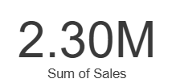
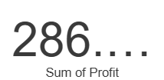
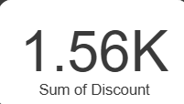
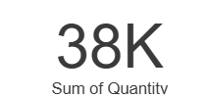
Key KPIs Selected:
Sales (2.30M): Total revenue generated.
Profit (286K): Earnings after cost & discounts.
Discount (1.56K): Total value of discounts applied.
Quantity (38K): Total units sold.

Slide 4
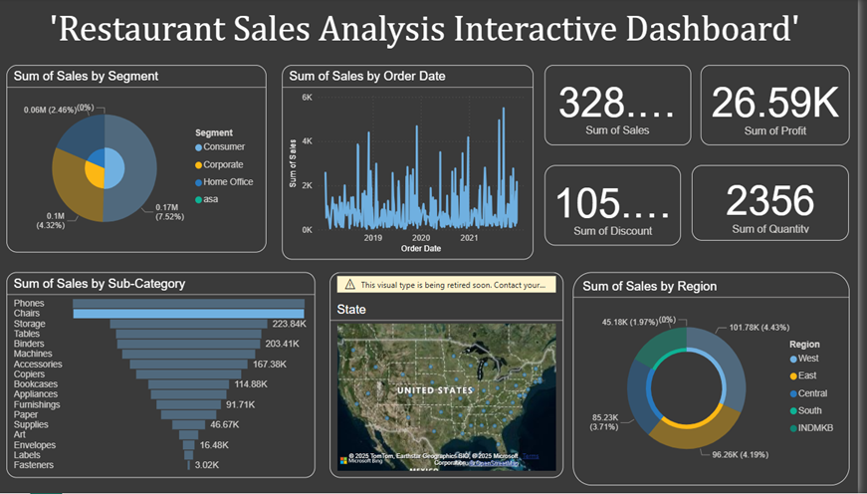

Slide 5
Key Insights
📌 Consumer segment leads in sales.
📌 Phones & Chairs are top-selling sub-categories.
📌 West region contributes maximum sales.
📌 Sales trend grew strongly after 2020.

Slide 6
Conclusions
Business can focus more on high-selling categories.
Optimize discounts to improve profit.
Expand in regions with lower sales.

